Slide 1

Gender Pay Gap: Predicting Income Based on Demographic Data
Katie Peterson
Supervised Learning Capstone
May 2018
Photo: Getty Images

Slide 2
Research Questions
What demographic data is the best determinant for a person to have a higher income?
Level of education?
Occupation?
Race?
Do these features differ between men and women?
Notes:
Part predictive and part explanatory (can’t change sex or race, but can change level of education, occupation, etc)

Slide 3
Data Set - 1994 Census Bureau Database
~32,000 working people over the age of 16, who made over $100 that year and who are representative of the larger population
Tracked if income was over or under $50,000
Note: After accounting for inflation and cost of living increases, $50,000 in 1994 would be worth approximately $84,500 in 2018.
Data Source: UCI Machine Learning Repository
Source: Bureau of Labor and Statistics

Slide 4
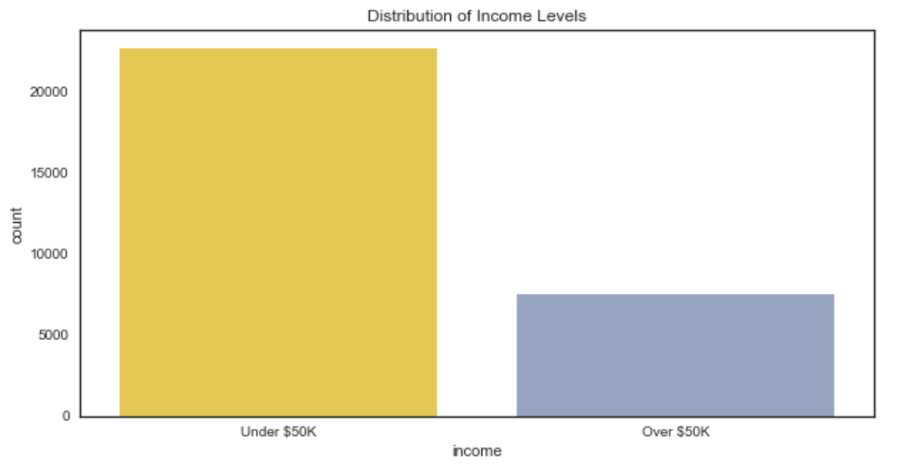
Counts of Income Level
Notes:
Class Imbalance - need to under or over sample for training and testing
Use Receiver Operating Characteristic Area Under the Curve score, which is unbiased for unbalanced sets as it compares the true positive and false positive rates

Slide 5
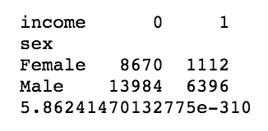
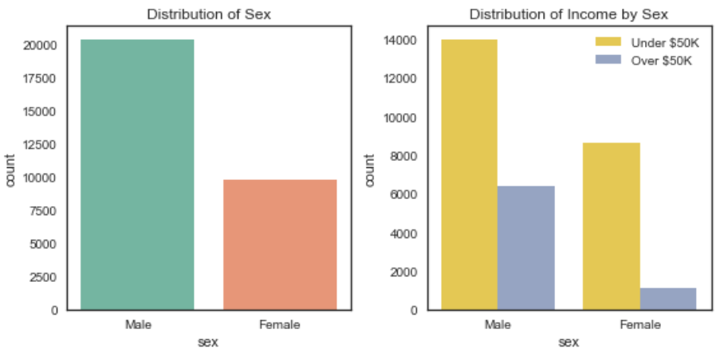
Income Level, by Sex

Slide 6
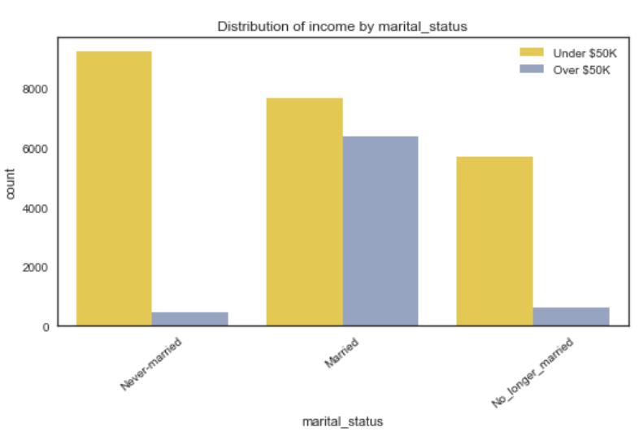
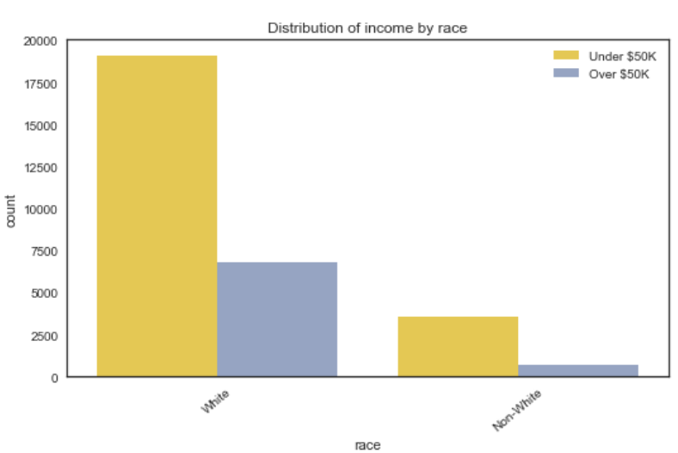
Other Interesting Insights - Marital Status and Race

Slide 7
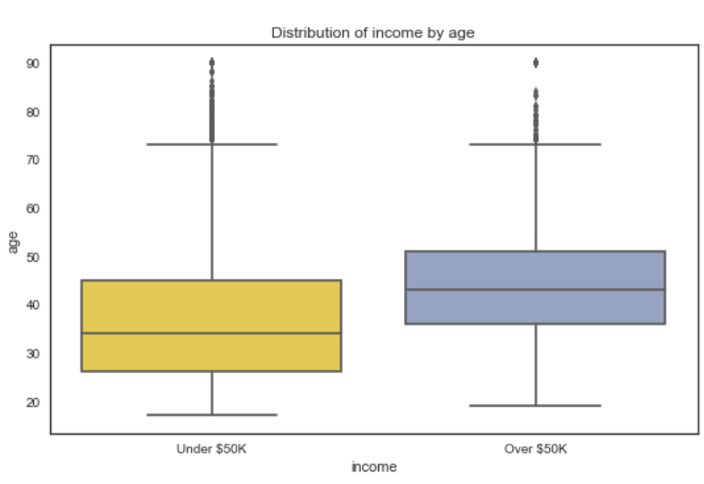
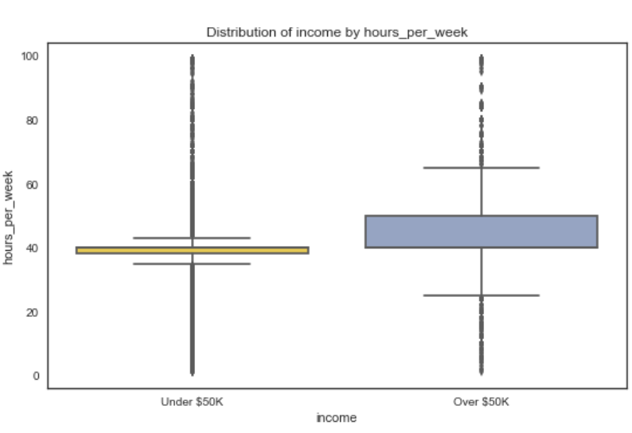
Other Interesting Insights - Age and Hours per Week

Slide 8
Feature Engineering

Slide 9
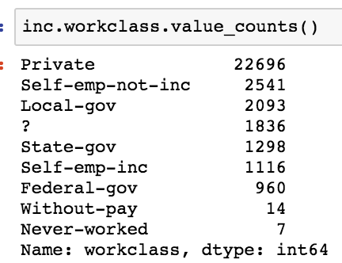
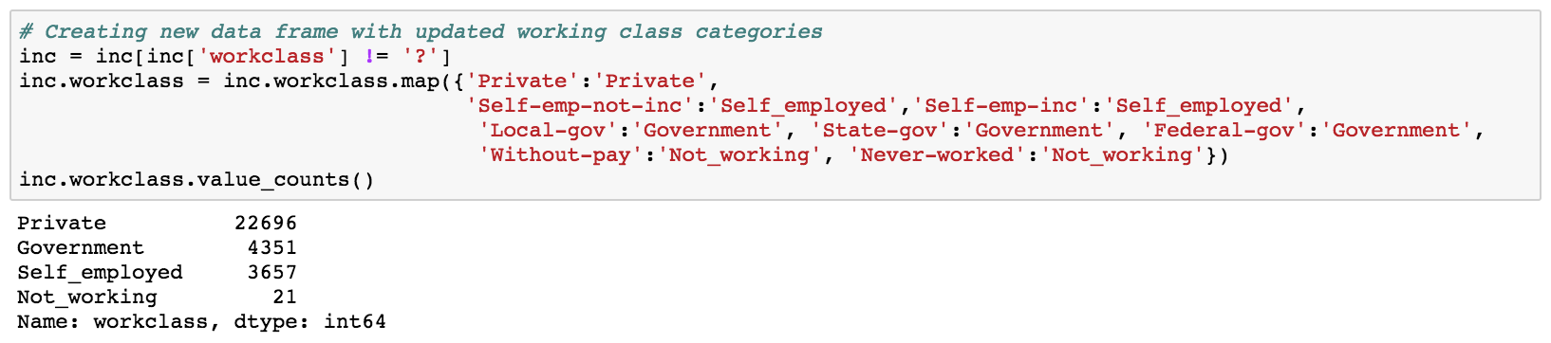
Feature Engineering - Working Class

Slide 10
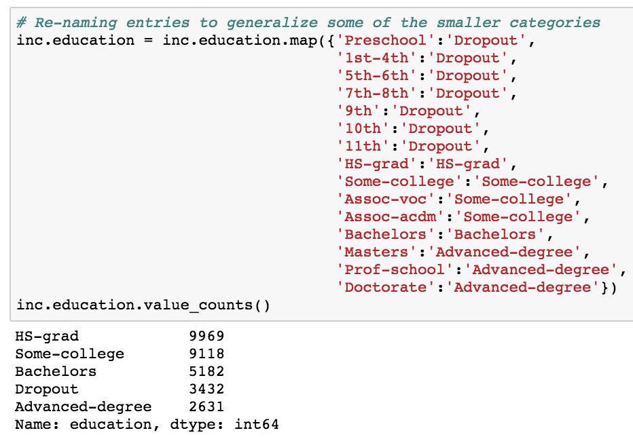
Feature Engineering - Education

Slide 11
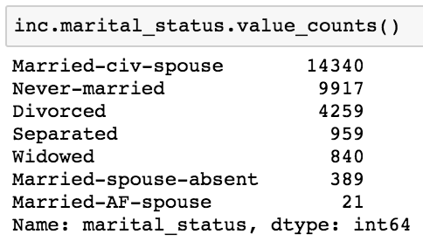
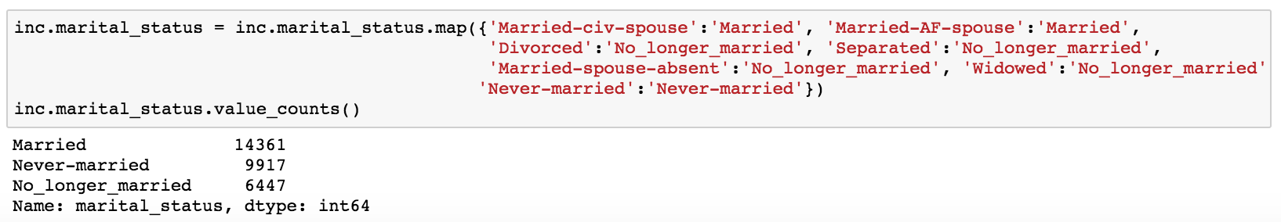
Feature Engineering - Marital Status

Slide 12
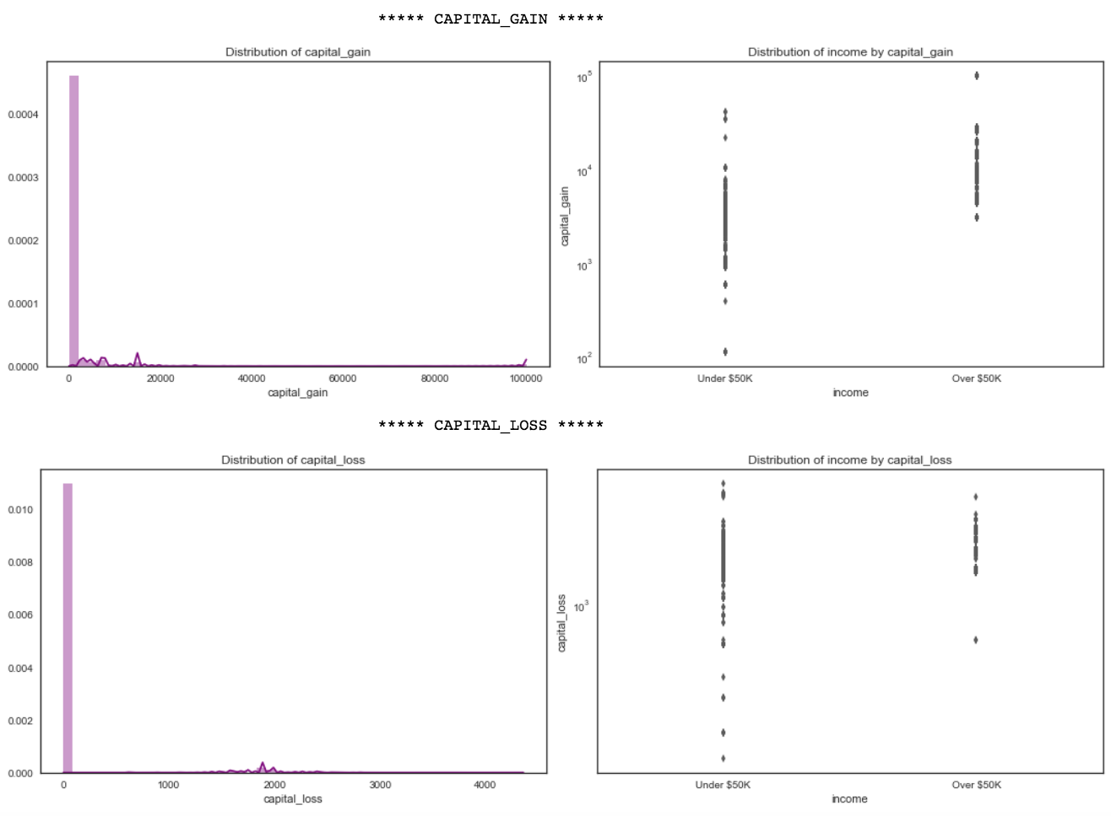
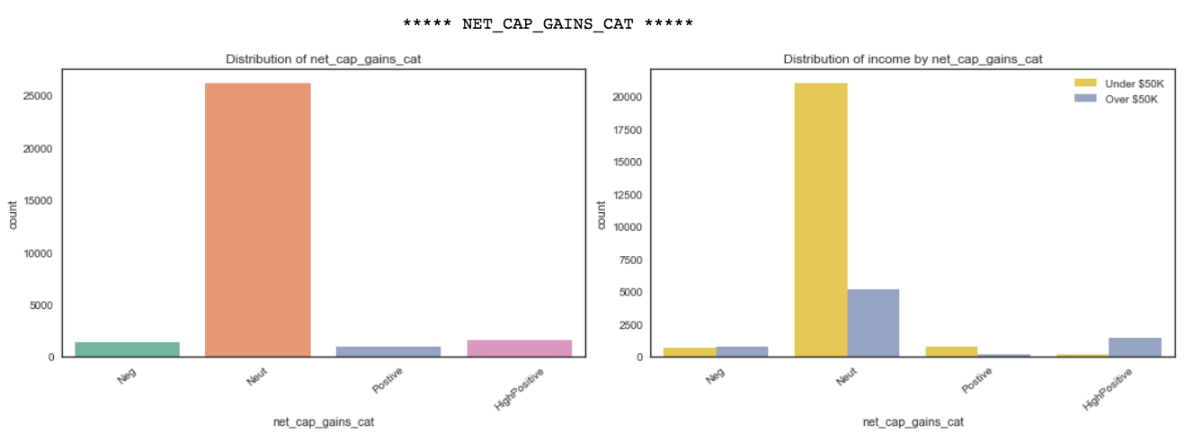
Feature Engineering - Capital Gains

Slide 13
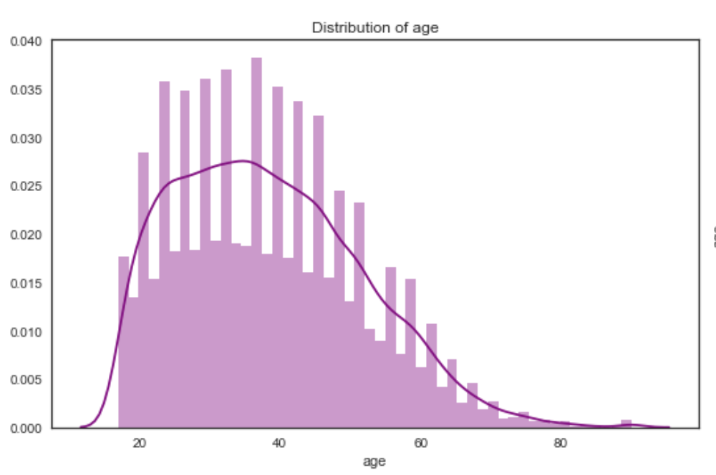
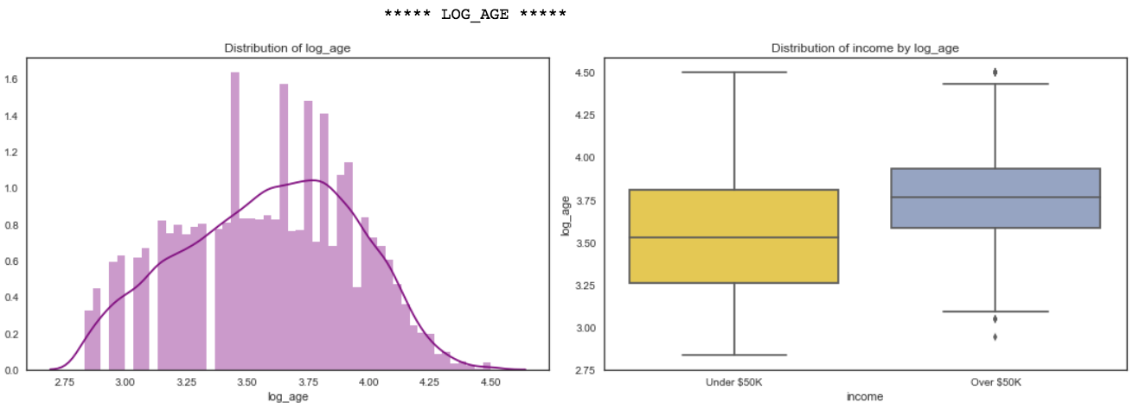
Feature Engineering - Age

Slide 14
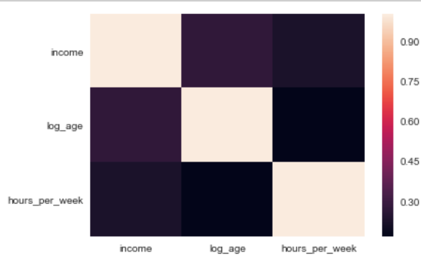
Feature Engineering - Independence

Slide 15
Modeling
Logistic Regression
K Nearest Neighbors Classifier
Random Forest
Gradient Boosting Classifier
**All with under-sampling on training set
Notes:
Train and tests separated with random stratified split 25% test set

Slide 16
Logistic Regression
Default Settings
Accuracy: 85.28 (+/- 1)%
ROC Score: 0.9048 (+/- 0.01)
Optimized the regularization parameter, solver algorithm, and L1 (LASSO) vs. L2 (Ridge) regression penalties
Accuracy: 85.31 (+/- 1)%
ROC Score: 0.9049 (+/- 0.01)
Provides probability scores
Robust to noise in data
Interpretability of odds ratios from coefficients
Struggles with large number of categorical features
Notes:
Features with improved odds for higher earnings: highly positive capital gains (and also negative capital gains), Bachelor’s degree or other advanced degree, and age.
Use Receiver Operating Characteristic Area Under the Curve score, which is unbiased for unbalanced sets as it compares the true positive and false positive rates

Slide 17
K Nearest Neighbors Classifier
Default Settings
Accuracy: 82.4 (+/- 2)%
ROC Score: 0.8453 (+/- 0.03)
Optimized the number of neighbors used to compare and classify points
Accuracy: 82.9 (+/- 2)%
ROC Score: 0.8751 (+/- 0.03)
Classifies based on closeness of other known observations
Lazy learning responds to changes in inputs
Longer computation time in test set
High dimensionality reduces effectiveness

Slide 18
Random Forest
Default Settings
Accuracy: 83.0 (+/- 1)%
ROC Score: 0.8610 (+/- 0.03)
Optimized the number of estimators, minimum samples split, maximum depth
Accuracy: 85.12 (+/- 2)%
ROC Score: 0.9055 (+/- 0.01)
Typically high performer
Guards against overfitting
Provides feature importance
Black box
Not able to predict outside sample
Optimization is computationally expensive

Slide 19
Gradient Boosting Classifier
Default Settings
Accuracy: 85.7 (+/- 2)%
ROC Score: 0.9093 (+/- 0.01)
Optimized the minimum samples split, minimum samples per leaf, maximum depth, number of features considered, fraction of observations used to subsample, and number of estimators
Accuracy : 85.4 (+/- 2)%
ROC Score: 0.9097 (+/- 0.01)
Minimizes loss function
Subsampling and learning rate help prevent overfitting
Robust to outliers and missing data
Can be prone to overfitting
Optimization can be computationally expensive

Slide 20
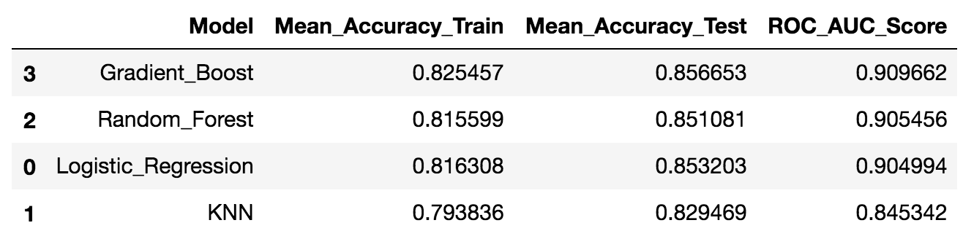
Overall Model Analysis

Slide 21
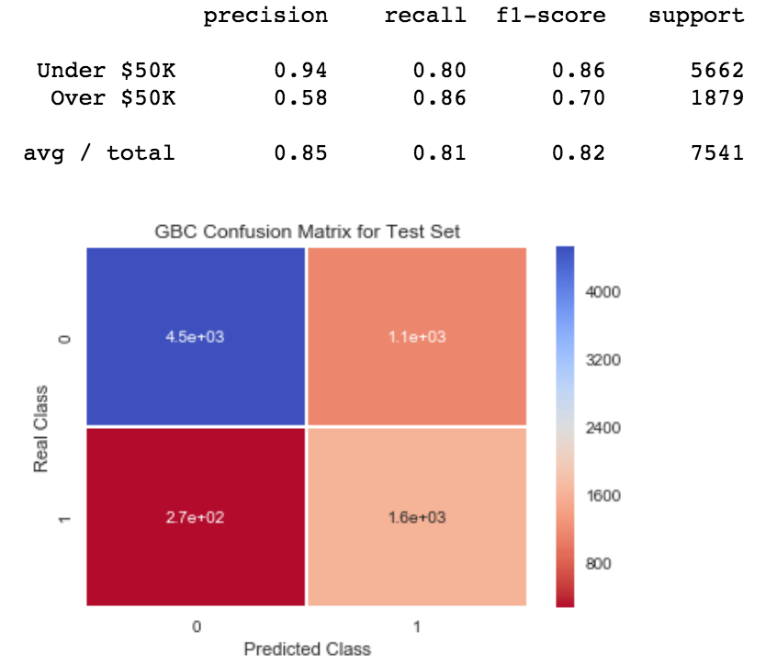
Error Analysis - Gradient Boosting
Precision (positive outcomes correctly predicted) was higher for predicting incomes under $50,000
Recall (actual positives correctly identified) was higher for predicting incomes over $50,000
F1-score (weighted average of precision and recall) was higher for predicting incomes under $50,000

Slide 22
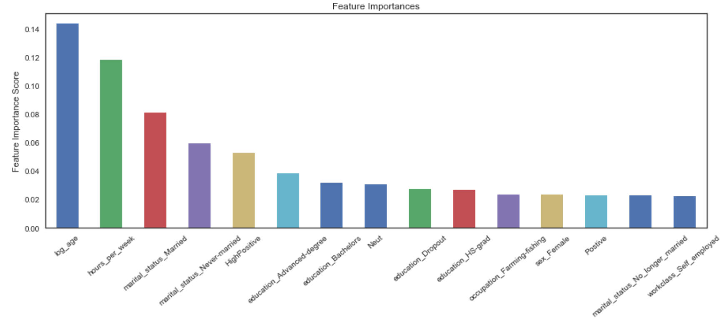
Model Interpretation - Feature Importances
1st: Age
2nd: Hours worked per week
3rd+4th: Being Married or Never Married
5th: High capital gains
6th and 7th: Post-secondary degrees
Notes:
Models run with data for only males provided almost identical feature importances (only Married and hours per week switched places)

Slide 23
Model Interpretation - Feature Importances
1st: Age
2nd: Hours worked per week
3rd+4th: Being Married or Never Married
5th: High capital gains
6th and 7th: Post-secondary degrees
Notes:
Models run with data for only males provided almost identical feature importances (only Married and hours per week switched places)

Slide 24
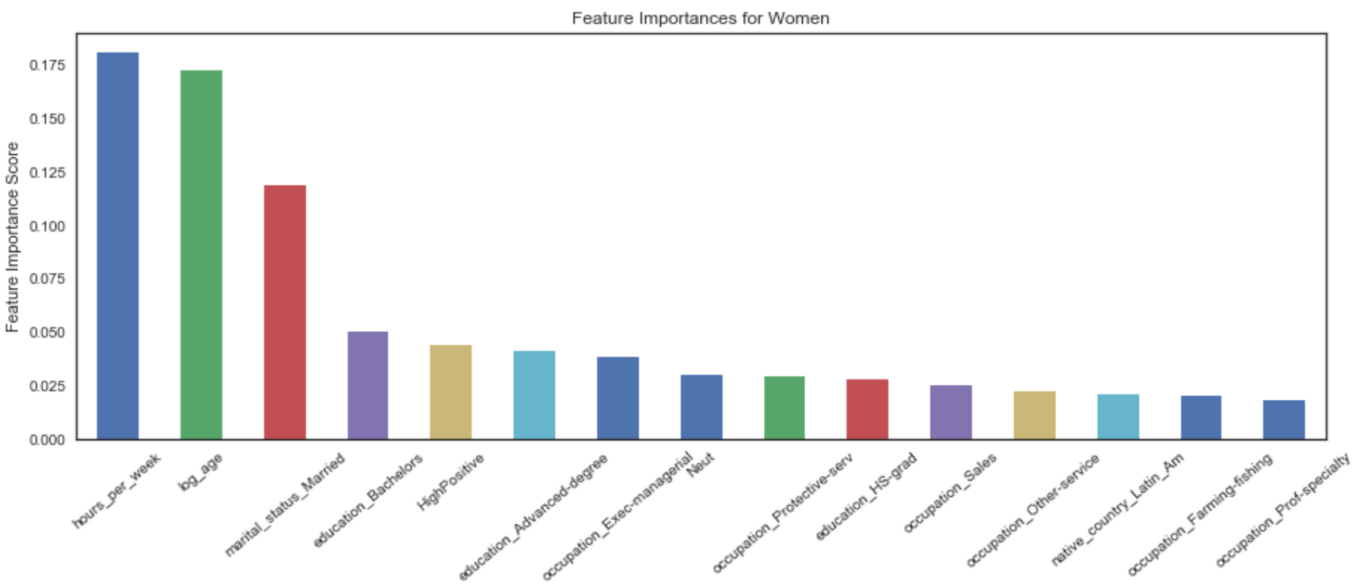
Gender Pay Gap - Model with only Females
1st: Hours worked per week
2nd: Age
3rd: Being Married
4th + 6th : Post-secondary degrees
5th: High capital gains
Notes:
Hours worked per week jumped into most important (from 2nd for overall data)

Slide 25
Conclusion
While people can’t change their age (without waiting), they can change all of the other demographic indicators that are indicative of earning more money
Demographic Indicator Characteristics of Individual
Being married Interpersonal skills, commitment
Number of hours worked per week Grit, persistence, passion
High capital gains Risk/reward
Bachelor’s degree and other advanced degrees Critical thinking skills, discipline

Slide 26
Conclusion
While people can’t change their age (without waiting), they can change all of the other demographic indicators that are indicative of earning more money
Demographic Indicator Characteristics of Individual
Being married Interpersonal skills, commitment
Number of hours worked per week Grit, persistence, passion
High capital gains Risk/reward
Bachelor’s degree and other advanced degrees Critical thinking skills, discipline

Slide 27
Final Thoughts
Opportunities for further exploration
How have these indicators changed since 1994?
How do these indicators compare to the income levels of other developed countries?
What indicators are most important for predicting if minority races earn higher incomes?

Slide 28
Thanks!
Link to codebook

